Slide 1



NYC
Story Telling Case Study
PPT - II

Slide 2
Agenda
1. | Objective
2. | Background
3. | Key Findings
4. | Recommendations
5. | Data Methodology

Slide 3
Objective
Share insights and strategic recommendations aimed at optimizing property acquisitions, price negotiations, service enhancements, and user-centric property listing optimization to maximize business growth and customer experience.
These presentations aim to guide the targeted audience in making informed decisions and implementing strategic improvements using the analysis results of the New York Airbnb dataset.

Slide 4
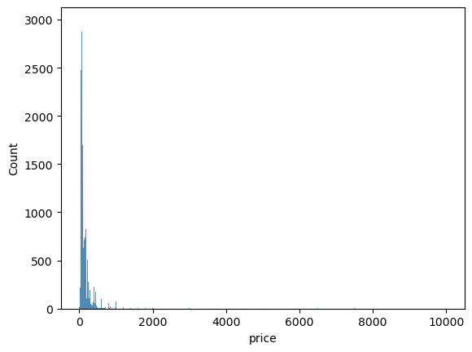
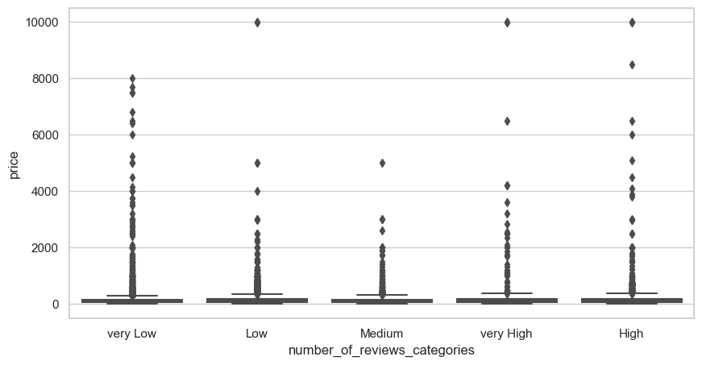
Key Findings
Pricing Insights:
Majority of listings fall within lower price categories indicating price sensitivity in customer choices.
Higher prices are associated with lower review likelihood, possibly impacting customer satisfaction.

Slide 5
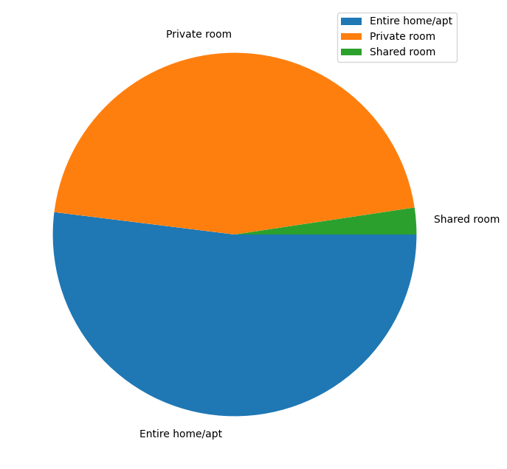
Key Findings
Property Types:
'Entire home/apt' listings are the most preferred, indicating a higher demand for these property types.

Slide 6
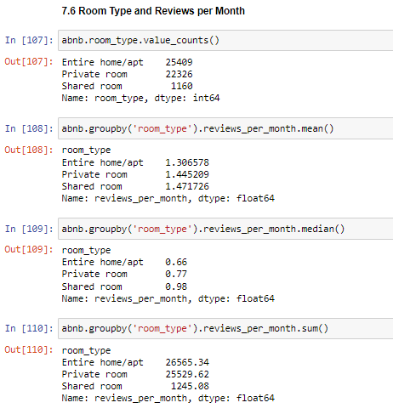

Key Findings
User Behavior:
Shared rooms tend to receive fewer reviews and possibly attract lesser customer interest.

Slide 7
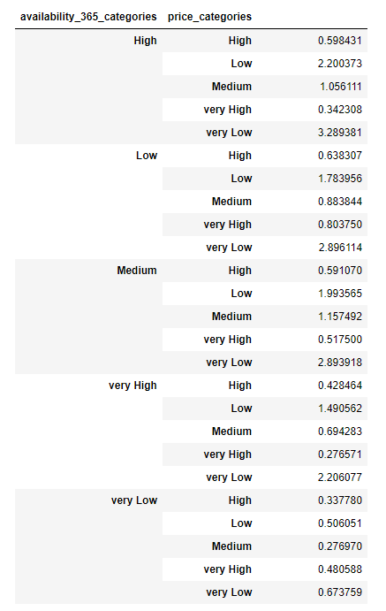
Key Findings
Availability & Pricing:
Listings with very high availability and very low prices tend to generate more reviews, implying the potential value of this pricing strategy.

Slide 8
Recommendations
Price Adjustment: Adjust pricing strategies to align with the 'very low' or 'low' categories, which are more likely to attract reviews and potentially increase demand.
Property Diversification: Encourage more listings under 'Entire home/apt' categories as they are in high demand. Adjust existing listings or focus on acquiring similar properties.
Optimize Shared Room Listings: Enhance the appeal of shared rooms by either adjusting pricing strategies or introducing promotional activities to increase their traction.
Improve User Engagement: Optimize the property listings for better user experience to attract more customers. Highlight properties with high availability and competitive pricing to improve customer traction.

Slide 9
Data Methodology
Introduction
The methodology aims to conduct a comprehensive Exploratory Data Analysis (EDA) on the Airbnb NYC dataset. The dataset includes various features related to properties listed on Airbnb in New York City.
Data Collection and Preparation
Data Importing: Utilized Pandas library to read the dataset ('AB_NYC_2019.csv').
Data Understanding: Displayed the first few rows to gain an initial understanding of the data structure.
Feature Engineering and Categorization
Availability, Nights, Reviews, and Pricing Categories: Categorized columns including 'availability_365', 'minimum_nights', 'number_of_reviews', and 'price' into five distinct categories using defined conditional functions.
Data Cleaning and Column Adjustments
Data Type Corrections: Transformed the 'last_review' column to 'datetime64' data type.
Column Adjustments: Identified categorical, numerical, coordinates, and date columns and displayed their content for a preliminary understanding.
Missing Values Analysis
Evaluation of Missing Values: Investigated the presence of missing values in columns, specifically focusing on 'last_review' and 'reviews_per_month' columns.

Slide 10
Data Methodology
Univariate Analysis
Exploration of Features: Analyzed individual features including 'host_name', 'neighbourhood_group', 'price', 'minimum_nights', 'number_of_reviews', 'reviews_per_month', 'calculated_host_listings_count', and 'availability_365'.
Visualization: Utilized various visualizations such as bar plots, box plots, histograms, and pie charts to understand the distributions and characteristics of different features.
Bivariate and Multivariate Analysis
Correlation Analysis: Explored correlations among numerical columns using correlation matrices and visualizations.
Top Correlations: Identified and examined top meaningful correlations within the dataset.
Relationship Analysis: Studied the relationships between room types, number of reviews, prices, and availability for further insights.
Data Saving
Export of Updated Data: Saved the manipulated dataset to 'AB_NYC_2019_updated.csv' after categorization and adjustments.
Conclusion and Recommendations
Insights: Derived insights into the impact of various categories on prices, reviews, and customer preferences.
Recommendations: Suggested adjustments such as keeping minimum nights lower, modifying prices for higher availability, and understanding property features more customer-oriented.

Slide 11
Data Methodology
Implications
This methodology provides a foundation for making data-driven decisions and more in-depth analyses related to Airbnb's business operations.
Further Steps
The methodology serves as a basis for future advanced analyses, predictive modelling, and strategic decision-making in the context of Airbnb's property listings.

